Slide 1
BCB Python Workshop 03 23 2018
Urminder Singh

Slide 2
Chapter 0
Prologue

Slide 3
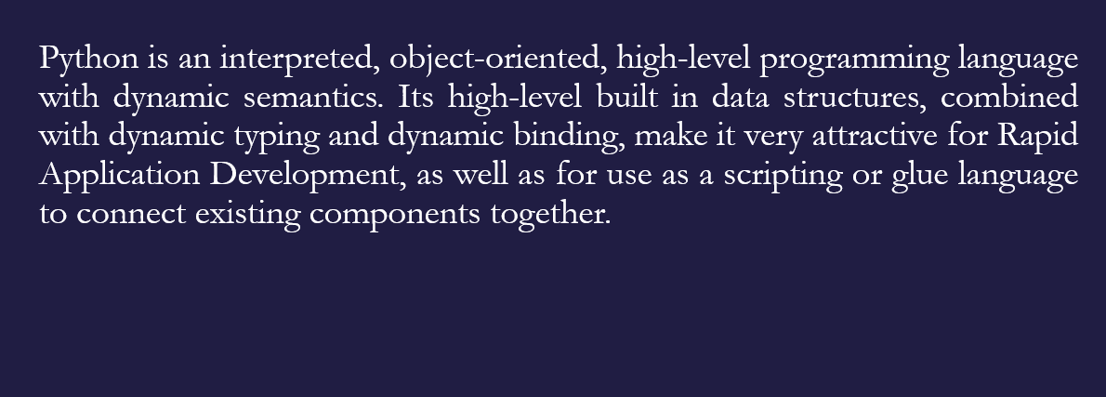
What is Python?
Ref: https://www.python.org/doc/essays/blurb/

Slide 4
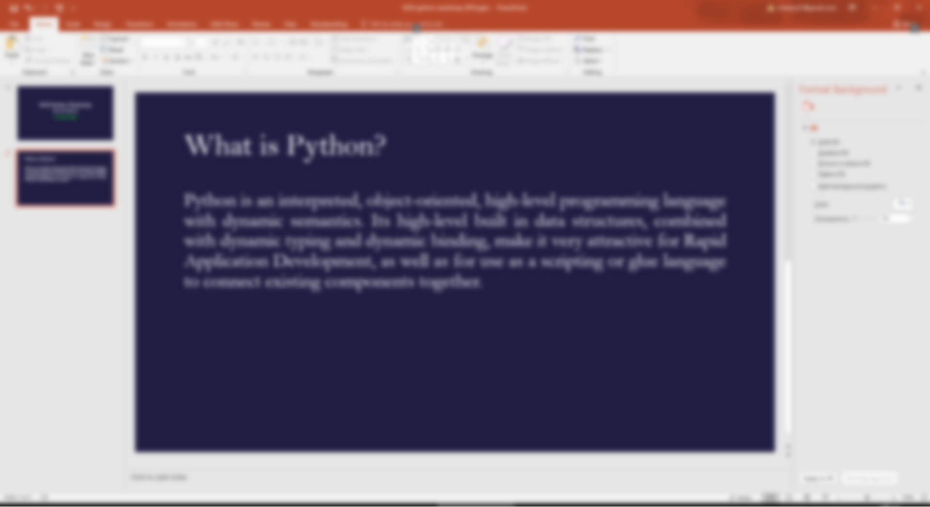

What is Python?

Slide 5


Brief history of Python
Guido van Rossum started developing his own language in 1989 Christmas holidays.
Named it Python after “Monty Python’s Flying Circus”
Q. To learn Python, do I have to like “Monty Python’s Flying Circus”
A. No, but it helps. :) [Ref: https://docs.python.org ]
Python was first used in the Amoeba project.
“In February 1991, after just over a year of development, I decided to post to USENET. The rest is in the Misc/HISTORY file.”
Python logo, 1990s–2005

Slide 6
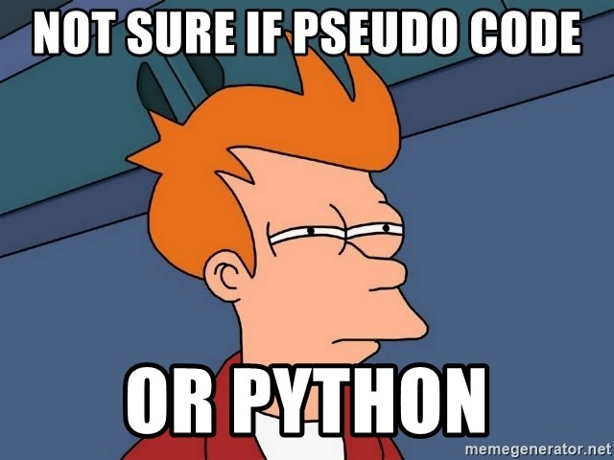
Why Python
Python is great for beginners
Python is high level language and easy to learn!
Python is versatile
Applications include data analysis, web development, game development
Python has great modules and libraries
PyPI “Python Package Index is a repository of software for the Python programming language. There are currently 132368 packages here.”
Python is supported by many platforms Linux/Windows/Mac
Python is growing rapidly. It is one of the 3 official languages at Google.

Slide 7
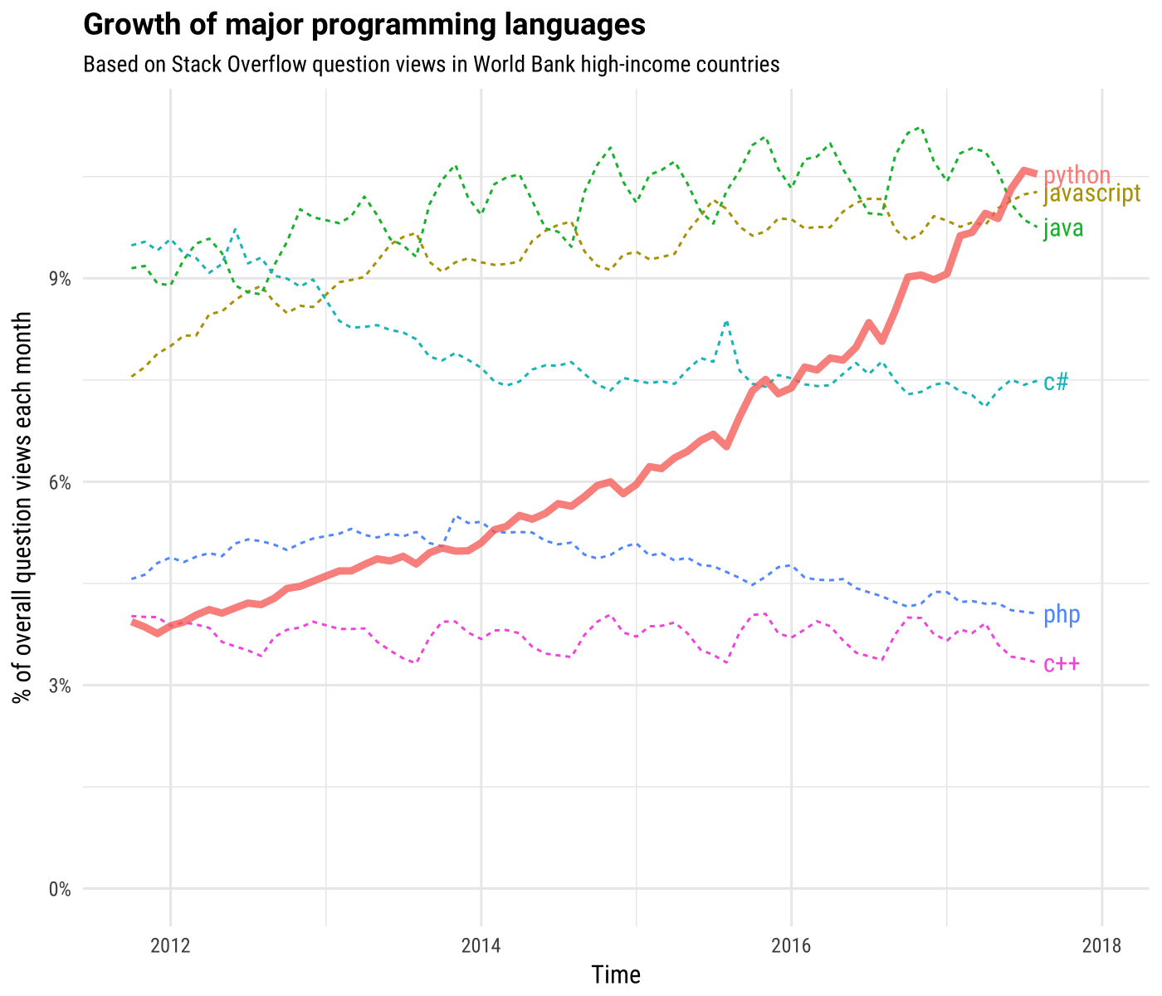
Ref: http://news.codecademy.com/why-learn-python/

Slide 8






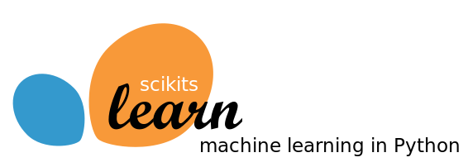


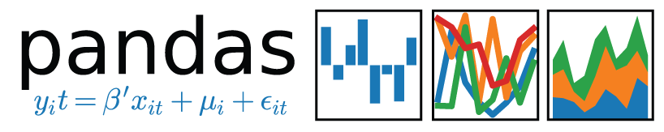

Few awesome examples of Python work

Slide 10
What is Python, seriously?
Python is free and open source high level, interpreted object oriented programming language
Free and open source: costs $0 and you can see the python source code
High level: closer to humans than to machine, easy to write and read
Interpreted: executes directly and freely without compiling
Object oriented: programming paradigm that models data into classes and objects
Programming language: language used to interact with computers

Slide 11
Getting Started
Downloading Python is free
Python comes preinstalled in most linux distros
https://www.python.org/downloads/
Python 2 vs Python 3
Python 2.x is legacy, Python 3.x is the present and future of the language
Python 3.x is not backwards compatible with Python 2.x
As of now, Python 2.x has more library support and is used more
For a beginner, Python 2.x vs Python 3.x shouldn’t matter

Slide 12
Setting up Python 2.7.x
Open “Software Center”
Search for “Python” and install Python 2.7.x
Go to Start → IDLE(Python GUI)
If working on personal laptop/computer (Windows)
Download and install python for windows: https://www.python.org/downloads/
Go to Start → IDLE(Python GUI)
For linux and mac users
Open Terminal and type “python”

Slide 13
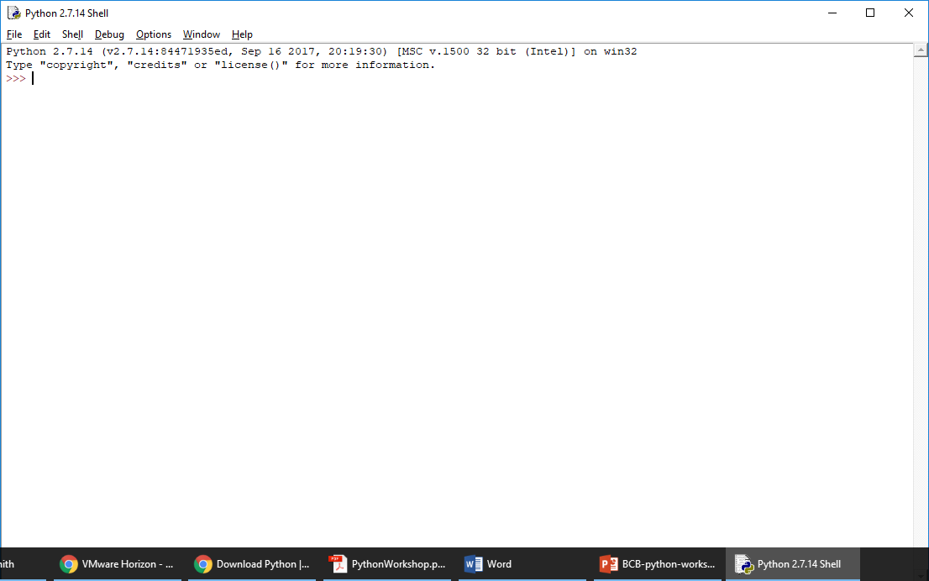
Congratulations! you’re ready to code in Python

Slide 14
Chapter I
First Python Program

Slide 15
Printing text
Windows users
In Python Shell go to “File” → “New File”
Linux and Mac users
Use any text editor (gedit, TextEdit, Vim, nano etc.) and create a new file
In the new file write
print “OK Computer”
Save file as “myfirst.py”
Windows users: Go to “Run” → “Run Module” or press F5 key.
Linux and Mac: On terminal type python myfirst.py and enter

Slide 16
Comments in Python
A single line comment in python starts with “#” character
Multiline comments start and ends with ‘’’ or “””.
Now add comments to “myfirst.py” before the print statement
# This is a single line comment
‘’’ This
is a
multiline
comment
‘’’
Did anything change after executing the code with comments?

Slide 17
Few more “print” examples python
“print” always prints in newline, use “print something” followed by a comma to print next print statement on same line
print “OK Computer”,
print “OKNOTOK” OK Computer OKNOTOK
#Second Option
print “OK Computer”, “OKNOTOK”

Slide 18
Strings
“str” class in python defines string objects
Strings are enclosed by either double or single quotes
Multiline string can be defined using triple quotes
stringA=“A string in double quotes”
stringB=‘A string in single quotes’
stringC=‘’’A multiline
String in triple quotes’’’
Characters in a string can be accessed using [ ] operator
print stringA[0] A
Strings are immutable i.e. can’t be changed once created
stringA[0]=‘C’
Note: “stringA”, “stringB” and “stringC” are known as variables

Slide 19
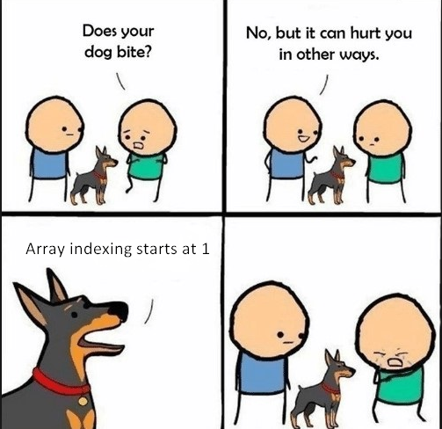
String slices
Slice syntax is easy way to refer to substrings in a string
stringD=“Blackstar”
print stringD[2:5] “ack”
print stringD[4:] “kstar”
print stringD[:-1] “Blacksta”
print stringD[-4:-1] “sta”
B | l | a | c | k | s | t | a | r
0 | 1 | 2 | 3 | 4 | 5 | 6 | 7 | 8
-9 | -8 | -7 | -6 | -5 | -4 | -3 | -2 | -1

Slide 20
String methods
“str” class defines many handy methods for string operations
For complete list of methods https://docs.python.org/2/library/stdtypes.html#string-methods
Method | Description
str.capitalize() | Return a copy of the string with its first character capitalized and the rest lowercased.
str.count(sub[, start[, end]]) | Return the number of non-overlapping occurrences of substring sub in the range [start, end]. Optional arguments start and end are interpreted as in slice notation.
str.find(sub[, start[, end]]) | Return the lowest index in the string where substring sub is found within the slice s[start:end]. Optional arguments start and end are interpreted as in slice notation. Return -1 if sub is not found.
str.isdigit() | Return true if all characters in the string are digits and there is at least one character, false otherwise.
str.replace(old, new[, count]) | Return a copy of the string with all occurrences of substring old replaced by new. If the optional argument count is given, only the first count occurrences are replaced.

Slide 21
Built-in functions on strings
Calculate length of a string using “len()”
len() is a built-in function in python
print len(stringA)
print len(“OK Computer”)
Concatenate strings using “+” operator
print “OK” + str.capitalize(“computer”)
#same as below
print “OK” + “computer”.capitalize()
Can’t concatenate string and int type
print “Length of stringA”+str(len(stringA))
Note str(len(stringA)) converts len(stringA) and int to string so that it can be concatenated with another string. This is known as typecasting.

Slide 22
Few examples of string operations
s=“belisha beacon”
print s.capitalize() Belisha beacon
print s.count(‘a’) 2
print s.replace(‘e’,‘xx’) bxxlisha bxxacon
index=s.find(sha)
print “sha occurs at ”+str(index) sha occurs at 4
print “sha occurs at”, index sha occurs at 4
print s[1:5].replace('b','')+s[5:] elisha beacon

Slide 23
Variables in Python
Variables store information and are accessed/manipulated by the program. Variable names point to the memory locations where information is stored.
Different “types” of variables store different types of information e.g. str stores strings, int store integers, float stores real numbers etc.
In Python variable types are determined by the value referenced by that variable
var=“A string”
print type(var) <type 'str'>
var=2
print type(var) <type 'int'>

Slide 24
Mutable vs immutable

Slide 25
Python variable names
Can contain letters, numbers and underscores. Can’t start with a number.
Can’t be a reserved Python keyword
Reserved keywords have special meaning in python e.g. len is a function to get an object’s length
More reserved keywords:
and, as, assert, break, class, continue, def, del, elif, else, except, exec, finally, for, from, global, if, import, in, is, lambda, not, or, pass, print, raise, return, try, while, with, yield

Slide 26
Basic arithmetic operations
Let a=10 b=15 c=3.0
Operator | Description | Example | Output
+ Addition | Adds values on either side of the operator. | a+ b b + c | 25 18.0
- Subtraction | Subtracts right hand operand from left hand operand. | a - b b – c | -5 12.0
* Multiplication | Multiplies values on either side of the operator | a * b b * c | 150 45.0
/ Division | Divides left hand operand by right hand operand | b / a b / c b/float(a) or float(b)/a | 1 5.0 1.5
% Modulus | Divides left hand operand by right hand operand and returns remainder | b % a a % c | 5 1.0
** Exponent | Performs exponential (power) calculation on operators | a**b a**c | 1000000000000000 1000.0
// | Floor Division - The division of operands where the result is the quotient in which the digits after the decimal point are removed. | b//a b//c b//float(a) or float(b)//a | 1 5.0 1.0

Slide 27
You are ready for exercise 1 !!!
Go to folder exercises/excercise1 and open ex1.py
Read the questions and write your code in the space provided
Run your code when done
Estimated time to complete 15 mins

Slide 28
Chapter II
Data Structures in Python

Slide 29
Data structures
Data structure defines a particular way of organizing, storing and accessing data
Lists: An ordered collection of objects
Sets: An unordered collection of “immutable objects”
Dictionaries: A mutable data structure that stores key, value pairs

Slide 30
Lists
Lists are defined with [ ] and work similarly to strings
flowers = [‘Orchid’, ’Carnation’, ’Sunflower’, ‘Marigold’]
print flowers[1] ‘Carnation’
print flowers[2:] [‘Sunflower’, ‘Marigold’]
print len(flowers) 4
print len(flowers[2]) 9
flowers.remove(‘Orchid’ )
flowers.append(564)
flowers.extend(3.1415)
print flowers ['Carnation', 'Sunflower', 'Marigold', 564, 3.1415]

Slide 31
Sets
Sets are defined using the built-in set function, set()
s=set() #creates empty set
s.add(1) #add to set
print s set([1])
s=set([1,2,3,4,5,1,2,6,7,2]) #creates set from give list
print s set([1, 2, 3, 4, 5, 6, 7])
s=set(‘Mississippi’)
print s set(['i', 'p', 's', 'M'])

Slide 32
Dictionaries
Dictionary (dict) can be defined by using { }
d = {} #empty dict
d[1]=‘value 1’
d[2]=‘value 2’
print d {1: 'value 1', 2: 'value 2’}
d = {1:’value1’,2:’value2’,3:’value3’}
print d[1] ‘value1’
print d[5] KeyError: 5
d['x']='valueNA’
print d {1: 'value1', 2: 'value2', 3: 'value3', 'x': 'valueNA'}

Slide 33
You are ready for exercise 2 !!!
Go to the folder exercises/excercise2 and open ex1.py
Read the questions and write your code in the space provided
Run your code when done
Estimated time to complete 10 mins

Slide 34
Chapter III
Conditionals and Loops

Slide 35
Indentation
Python uses indentation to define code blocks
A code block is a lexical structure of the source code
E.g. use for loop to repeat statement 10 times
i=0
for i in range(10):
print i #prints 0,1,2…9
print i #prints 9
Note the colon (:) and indentation after the for statement. All the statements having larger and equal margin from left are interpreted as a part of the for block.

Slide 36
If statements
If statements or the if/else statements are used to execute/skip a code block based on a condition
Basic syntax looks like
if(condition1):
planA()
else:
planB()
Can have multiple conditions
if(condition1):
planA()
elif(condition2):
planB()
else:
planC()
Can be without else
if(condition1):
planA()

Slide 37
Logical expressions
The conditions checked by if statements are called logical expressions
A logical expression can have a value “True” or “False” only
If value for a condition is “True”, the corresponding code block will get executed otherwise it will be skipped

Slide 38
Comparison operators
Operator | Description | Example expression | Output
== | Equals to | ‘str1’ == ‘str1’ | True
!= | Not equal to | ‘str1’ != ‘str1’ | False
> | Greater than | 3 > 3 | False
>= | Greater than or equal to | 3 >= 3 | True
< | Less than | 5 < 8 | True
<= | Less than or equal to | 5 <= 8 | True
is | Is the same object | x=[‘1’,’2’] y=[‘1’,’2’] x is y y=x x is y | False True
or | Boolean OR | 5<8 or 5>8 | True
and | Boolean AND | 5<8 and 5>8 | False
in | Membership test | ‘s’ in ‘books’ | True
not | Boolean NOT | not ‘s’ in ‘books’ | False

Slide 39
Few examples on if-else
Open the file “if-else.py” under the examples directory
Run the “if-else.py” file and try to understand how if-else statements work.
Make changes to the if-else conditions to allow the user to enter a power till 7 but limit the range of number from 0 till 5
Add an additional 4th option to let user find the reciprocal of the number e.g. reciprocal of 5 is 1/5 = 0.2. What will be the reciprocal if user enters 0 ?? Can you handle this exception using an if-else statement

Slide 40
Loops
A loop is a structure which allows execution of a code block repeatedly until a terminating criteria is reached.
For loop: repeat a block of code fixed number of times
Requires starting and ending criteria
for i in range(0,10):
print I
range() is an in-built function that will generate a list of numbers. E.g. range(0,3) will generate [0,1,2] and so will range(3).
While loops run until a certain condition is satisfied
Requires a stopping criteria
x=0
while(x<10):
print x

Slide 41
Break and continue
break and continue are special statements. break is used to break out of the loop and continue is used to skip code block and return to for or while statement and start over.
mylist = [1,2,3,4,5,6,7,8]
for i in l:
if (i % 2==0): #skips any even number
continue
if (i == 7): #exits when i is equal to 7
break
print i prints 1,3,5

Slide 42
Few examples on loops
Open the file “loops.py” under the examples directory
Run the “loop.py” file and try to understand how for and while loop statements work.
Write a for or while loop that allows user to see the last n primes in the list. E.g. if input is 3 output should be 61, 67, 71

Slide 43
Updating values inside loops
Often we need to change values inside a loop depending on the computational problem
Be careful to initialize variables before the loop
l=[‘abc’, ‘def’]
string=‘’ #important to initialize string to empty string
for x in l:
string= string+x
print string #prints abcdef. Note: ‘’.join(l) does same thing
Example finding sum on first n natural numbers
n=5
totalsum=0 #important to initialize totalsum =0
for x in range(n+1):
totalsum=totalsum+x #adds numbers 0 till 5
print totalsum #prints 15

Slide 44
You are ready for exercise 3 !!!
Go to the folder exercises/excercise3 and open ex3.py
Read the questions and write your code in the space provided
Run your code when done
Estimated time to complete 15 mins

Slide 45
Chapter IV
Functions

